Slide 1


Slide 1
8055
Executive Meet – Credit Card Division
Nithin Thomas

Slide 2
Slide 1
Meeting Agenda
Executive Summary
Q and A !

Slide 3
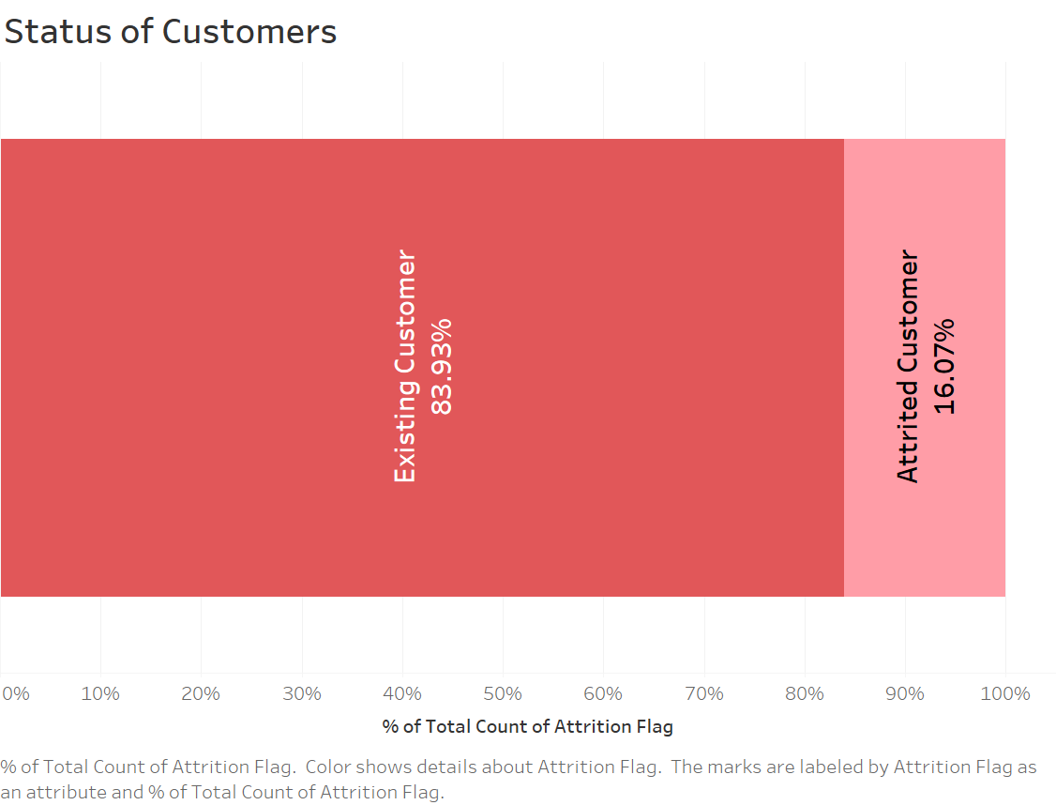
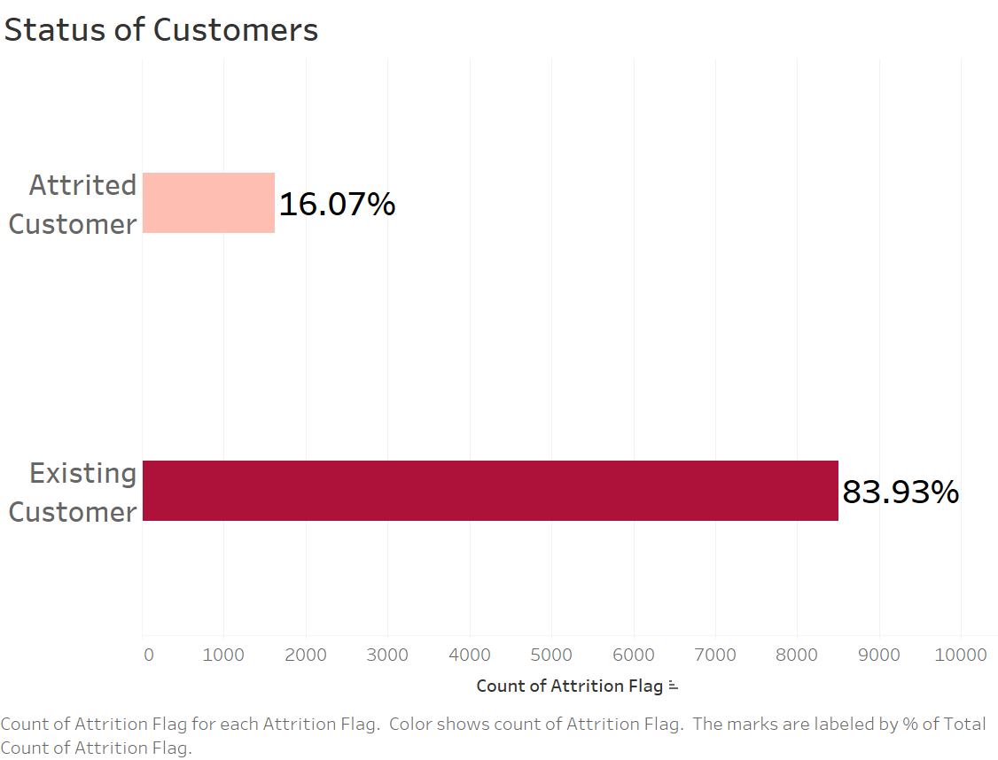
Slide 1
Executive Summary
Overview
Nbank credit card service face high attrition of customer in last 12 months.
By providing offers to the existing customer and providing special benefits to the customers who is likely to churn can decrease the attrition by
10%
RECOMMENDATIONS
Give priority to customer issues
Provide meaningful offers
Offer services based on customer spending history
Offer services to help increase credit score
Provide easy and fast customer service
Actions
Predict attrition of customer using transaction and customer disputes to take actions accordingly
Introduce products that is easy to use and reduce the number of disputes
Promote discounts on frequently purchased items
Take immediate actions on customers issues
CMO
Reduction by 10%
FMO
Notes:
last 12 months data, it was found that the attrition of customer is high for the credit card service.
16 approx. attrition.
offers and special discounts to its customers which can reduce the attrition by 10% in the coming quarter.
Actions to be taken for reducing the attrition
CMO and FMO
Recommendations

Slide 4

Slide 1
Q & A
Notes:
Welcome everyone to NBank Credit Card Division Executive meeting.
Myself Nithin Thomas will be running this presentation.
So lets get started with the meeting without further delay.

Slide 5
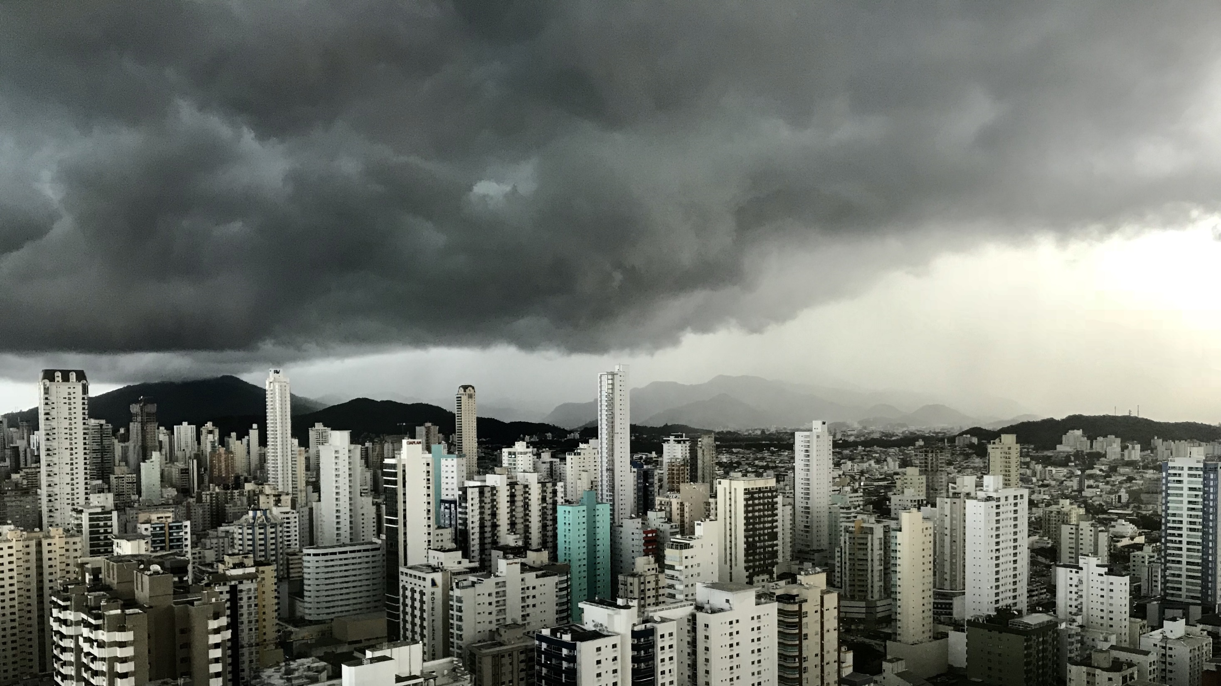
THANK YOU

